Slide 1
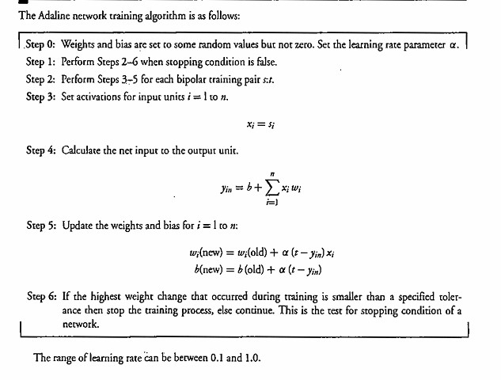

Slide 2
Adaline = Adaptive Linear Neuron
It is a simple artificial neuron/neural network model that learns from examples by changing its weights.
Think of it like a small calculator:
Adaptive means it learns by adjusting its weights based on the error.

Slide 3
Adaline Training Algorithm
Take input → Calculate output → Find error → Change weights → Repeat → Stop when weight changes become very small.
Step 0 – Set weights, bias and learning rate
First, we give some initial values to the weights and bias.
They should be random values and not zero.
For example:
W1​=0.2, W2​=0.3 b=0.1
We also set the learning rate:
α=0.1

Slide 4
What is a weight?
Weight = importance given to an input.
What is learning rate?
Learning rate tells how much the weight should change during learning.
the learning rate can be between 0.1 and 1.0.

Slide 5
Step 1 – Check the stopping condition
The algorithm says:
Perform Steps 2–6 when the stopping condition is false.
If training is not finished, continue training.
Stopping condition?
↓
FALSE
↓
Continue training
If the stopping condition becomes true:
STOP

Slide 6
Step 2 – Take a training pair
The Algo says to perform Steps 3–5 for each bipolar training pair.
A training pair means:
Input + Target answer
For example:
s=(1,−1) and t=1
Here: s = input t = correct/target answer
What is bipolar?
Bipolar values are: −1, +1
So an input can be:
X₁ = +1 and X₂ = -1

Slide 7
Step 3 – Set the input
The Algo gives:
xi​=si​
Simple meaning:
Take the input values from the training example and give them to the Adaline.
For example:
s=(1,−1)
Then:
X1​=1 X2​=−1

Slide 8
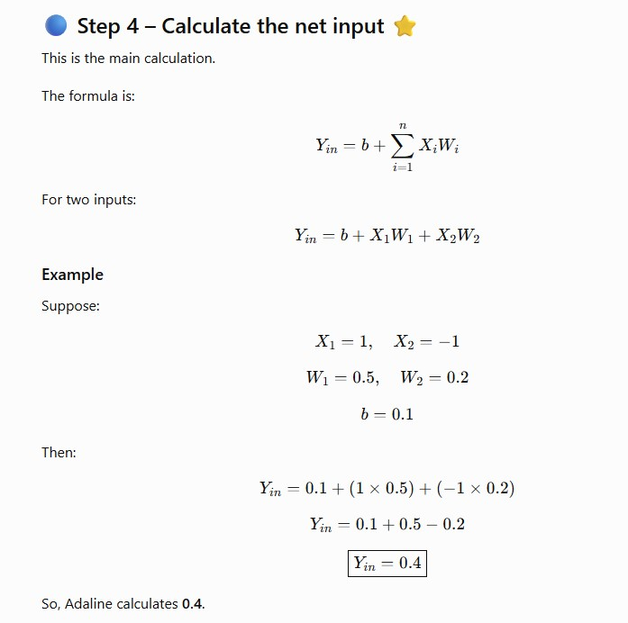
Step 4 – Calculate the net input

Slide 9
Step 5 – Update the weights and bias
The textbook gives:
Wi​(new)=Wi​(old)+α(t−Yin​)Xi​
For bias:
b(new)=b(old)+α(t−Yin​)
First, we calculate:
t−Yin​
This is the error.

Slide 10
Our example:
Target:
t=1
Adaline output:
Yin​=0.4
Therefore:
Error=1−0.4
Error=0.6​

Slide 11
Update W₁
We have:
W1​=0.5 α=0.1 X1​=1 Error=0.6
So:
W1​(new)=0.5+(0.1)(0.6)(1) =0.56
Therefore:
W1​(new)=0.56

Slide 12
Update W₂
We have:
W2​=0.2 X2​=−1
So:
W2​(new)=0.2+(0.1)(0.6)(−1) =0.14
Therefore:
W2​(new)=0.14

Slide 13
Update the bias
b(new)=b(old)+α(t−Yin​) =0.1+(0.1)(0.6) b(new)=0.16​
So:
 | Before | After
W₁ | 0.50 | 0.56
W₂ | 0.20 | 0.14
Bias | 0.10 | 0.16

Slide 14
Adaline is saying:
"My output has some error, so I will change my weights to get a better output next time."
This is how Adaline learns.

Slide 15
Step 6 – Decide whether to stop
If the highest weight change during training is smaller than the specified tolerance, stop training.
Simple meaning:
We check how much the weights are changing.
For example:
Round 1 → Weight change = 0.06
Round 2 → Weight change = 0.02
Round 3 → Weight change = 0.005
Round 4 → Weight change = 0.0005
Suppose the tolerance is:
0.001
Now:
0.0005<0.001

Slide 16
So:
✅ STOP TRAINING
But if the weight change is:
0.05
then:
0.05>0.001
❌ Do not stop
Continue training.

